Slide 1



Pointers

Slide 2
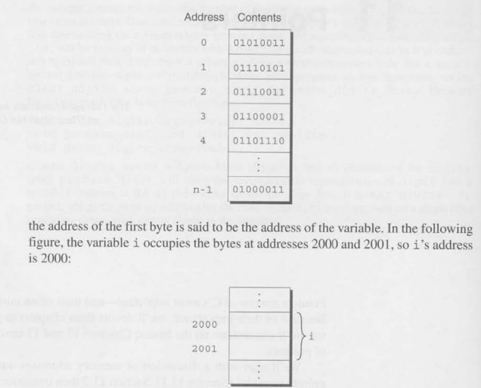
Pointer Variables

Slide 3
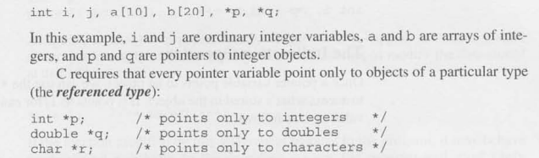
Declaring Pointer Variables

Slide 4
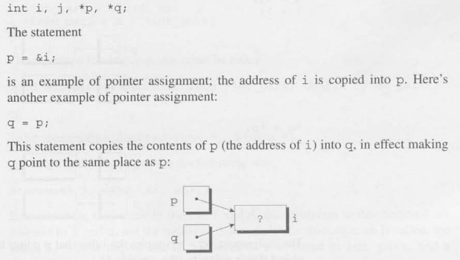
Pointer Assignment

Slide 5
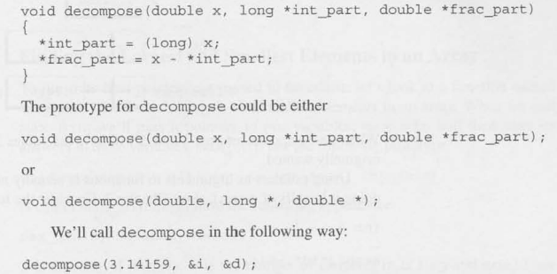
Pointers as Arguments

Slide 6
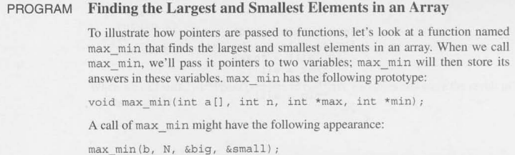

Slide 7

Constant to Protect Argument

Slide 8
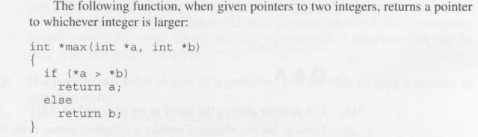
Pointer as Return Values

